Slide 1
Regression

Slide 2
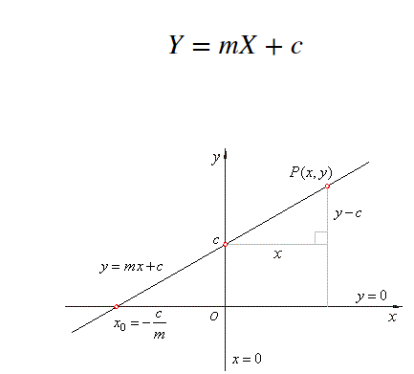
Regression
Linear Regression

Slide 3
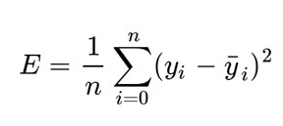
Linear Regression: Loss Function
Gradient descent is an iterative optimization algorithm to find the minimum of a function.
w = w – alpha * delta

Slide 4
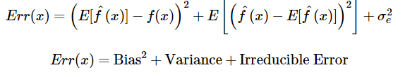
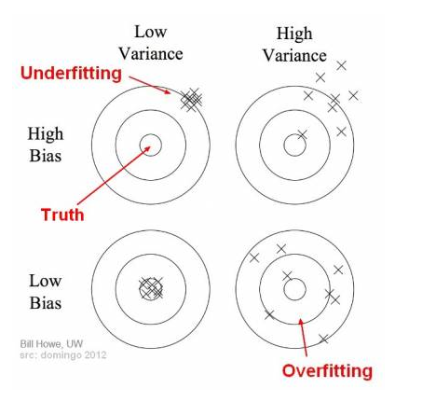
Bias and variance

Slide 5
High bias :good accuracy (test data)
High variance: good accuracy score(training)
Underfitting: high bias,low variance
Overfitting:low bias,high variance

Slide 6
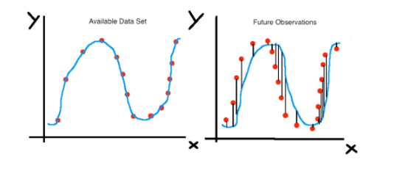
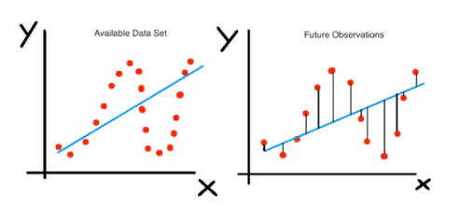
Fit lines
high variance
Low bias
low variance
high bias

Slide 7
Examples of low-bias and high-variance machine learning algorithms include: Decision Trees, k-Nearest Neighbors and Support Vector Machines.
Examples of high-bias and low-variance machine learning algorithms include: Linear Regression, Linear Discriminant Analysis and Logistic Regression.

Slide 8
It is highly important to restrict the features while modeling to minimize the risk of over fitting and this process is called regularization.
Loss=(y-yp)^2 linear
Loss= loss+lambda (m)^2 ridge
Loss= loss+lambda (co-efficients)^2
Loss=loss+lambda(|m|)

Slide 9

Ridge Regression
It shrinks the parameters, therefore it is mostly used to prevent multicollinearity.
It reduces the model complexity by coefficient shrinkage.
It uses L2 regularization technique.

Slide 10
Lasso regression
LASSO (Least Absolute Shrinkage Selector Operator)
It uses L1 regularization technique
It is generally used when we have more number of features, because it automatically does feature selection.

Slide 11
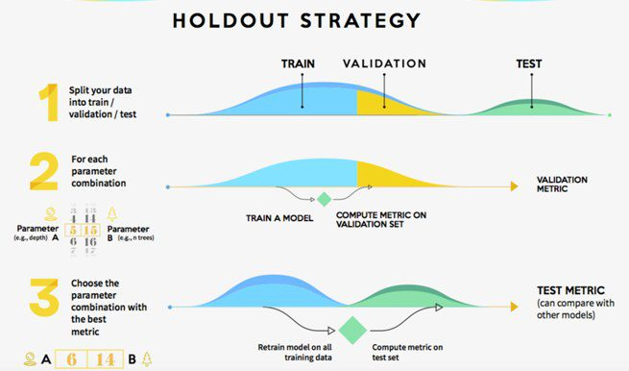

Slide 12
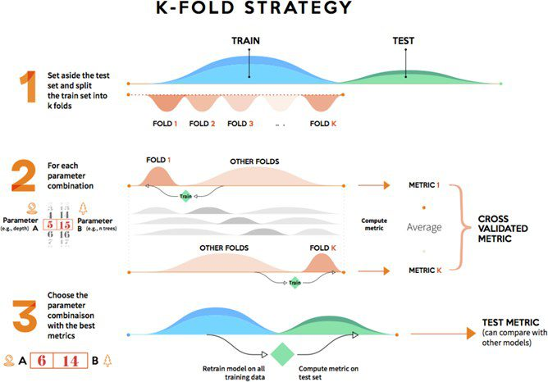

Slide 13
Understanding Factor Analysis
Factor analysis is commonly used in:
Data reduction
Scale development
The evaluation of the psychometric quality of a measure, and
The assessment of the dimensionality of a set of variables.

Slide 14

Factor analysis is a linear statistical model. It is used to explain the variance among the observed variable and condense a set of the observed variable into the unobserved variable called factors. Observed variables are modeled as a linear combination of factors and error terms

Slide 15
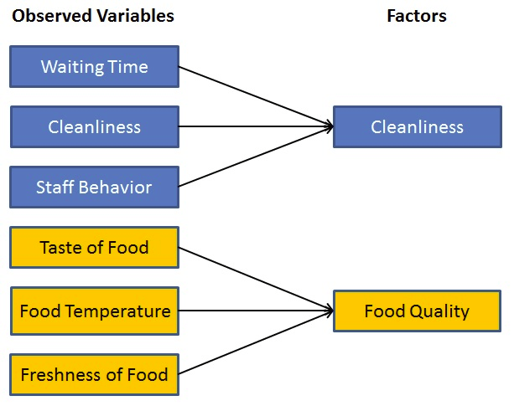

Slide 16
How does factor analysis work?
The primary objective of factor analysis is to reduce the number of observed variables and find unobservable variables.
Factor Extraction: In this step, the number of factors and approach for extraction selected using variance partitioning methods
Factor Rotation: There are lots of rotation methods that are available such as: Varimax rotation method, Quartimax rotation method, and Promax rotation method.

Slide 17
What is a factor?
A factor is a latent variable which describes the association among the number of observed variables. The maximum number of factors are equal to a number of observed variables. Every factor explains a certain variance in observed variables.
What are the factor loadings?
The factor loading is a matrix which shows the relationship of each variable to the underlying factor.

Slide 18
What is Eigenvalues?
Eigenvalues represent variance explained each factor from the total variance. It is also known as characteristic roots.
What are Communalities?
Commonalities are the sum of the squared loadings for each variable. It represents the common variance.

Slide 19
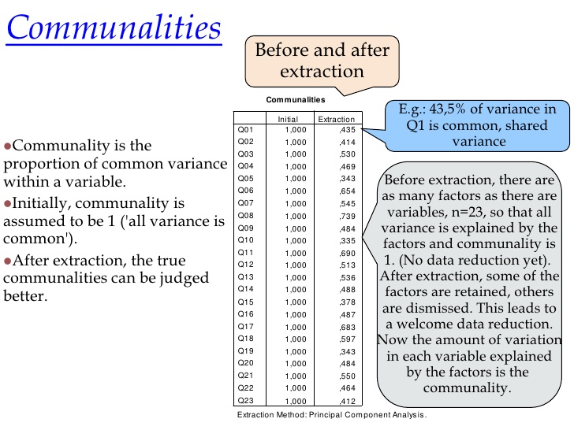

Slide 20
Steps in Factor Analysis
Factor analysis usually proceeds in four steps:
1st Step: the correlation matrix for all variables is computed
2nd Step: Factor extraction
3rd Step: Factor rotation
4th Step: Make final decisions about the number of underlying factors

Slide 21
Steps in Factor Analysis: The Correlation Matrix
1st Step: the correlation matrix
Generate a correlation matrix for all variables
Identify variables not related to other variables

Slide 22
Steps in Factor Analysis: The Correlation Matrix
⚪
Bartlett Test of Sphericity:
used to test the hypothesis the correlation matrix is an identity matrix
(all diagonal terms are 1 and all off-diagonal terms are 0).
⚪
If the value of the test statistic for sphericity is large and the associated significance level is small, it is unlikely that the population correlation matrix is an identity.
⚪
If the hypothesis that the population correlation matrix is an identity cannot be rejected because the observed significance level is large, the use of the factor model should be reconsidered.

Slide 23
Steps in Factor Analysis: The Correlation Matrix
⚪
The Kaiser-Meyer-Olkin (KMO) measure of sampling adequacy:
is an index for comparing the magnitude of the observed correlation coefficients to the magnitude of the partial correlation coefficients.
⚪
The closer the KMO measure to 1 indicate a sizeable sampling adequacy (.8 and higher are great, .7 is acceptable, .6 is mediocre, less than .5 is unaccaptable ).
⚪
Reasonably large values are needed for a good factor analysis. Small KMO values indicate that a factor analysis of the variables may not be a good idea.

Slide 24
Steps in Factor Analysis: Factor Extraction
2nd Step: Factor extraction
The primary objective of this stage is to determine the factors.
Initial decisions can be made here about the number of factors underlying a set of measured variables.
Estimates of initial factors are obtained using Principal components analysis.
The principal components analysis is the most commonly used extraction method . Other factor extraction methods include:
Maximum likelihood method
Principal axis factoring
Alpha method
Unweighted lease squares method
Generalized least square method
Image factoring.

Slide 25
Steps in Factor Analysis: Factor Extraction
In principal components analysis, linear combinations of the observed variables are formed.
The 1st principal component is the combination that accounts for the largest amount of variance in the sample (1st extracted factor).
The 2nd principle component accounts for the next largest amount of variance and is uncorrelated with the first (2nd extracted factor).
Successive components explain progressively smaller portions of the total sample variance, and all are uncorrelated with each other.

Slide 26
Steps in Factor Analysis: Factor Extraction

To decide on how many factors we need to represent the data, we use 2 statistical criteria:
Total Variance Explained
⚪
⚪
Eigen Values, and The Scree Plot.
Extraction Sums of Squared Loadings
Initial Eigenvalues
Comp onent
% of Variance
Cumulativ e %
% of Variance
Cumulativ e %

The determination of the number of factors is usually done by considering only factors with Eigen values greater than 1.
Total
Total
1
3.046 30.465 30.465
3.046 30.465 30.465
2
1.801 18.011 48.476
1.801 18.011 48.476
3
1.009 10.091 58.566
1.009 10.091 58.566
4
.934
9.336 67.902
Factors with a variance less than 1 are no better than a single variable, since each variable is expected to have a variance of 1.
5
.840
8.404 76.307

6
.711
7.107 83.414
7
.574
5.737 89.151
8
.440
4.396 93.547
9
.337
3.368 96.915
10 .308 3.085 100.000
Extraction Method: Principal Component Analysis.

Slide 27
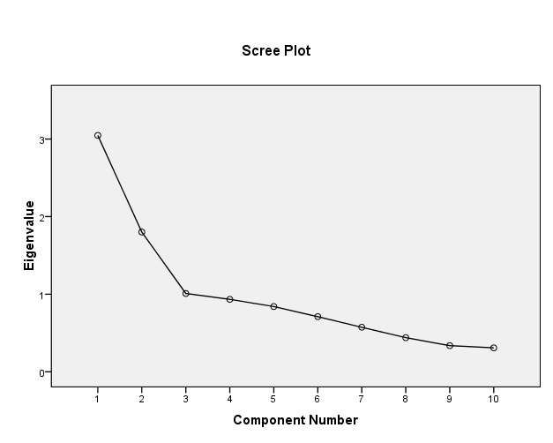
Steps in Factor Analysis: Factor Extraction
20

The examination of the Scree plot provides a visual of the total variance associated with each factor.

The steep slope shows the large factors.

The gradual trailing off (scree) shows the rest of the factors usually lower than an Eigen value of 1.

In choosing the number of factors, in addition to the statistical criteria, one should make initial decisions based on conceptual and theoretical grounds.

At this stage, the decision about the number of factors is not final.

Slide 28
Steps in Factor Analysis: Factor Extraction
Component Matrix using Principle Component Analysis
Component Matrixª
 | Component
 | 1 | 2 | 3
I discussed my frustrations and feelings with person(s) in school | .771 | -.271 | .121
I tried to develop a step-by-step plan of action to remedy the problems | .545 | .530 | .264
I expressed my emotions to my family and close friends | .580 | -.311 | .265
I read, attended workshops, or sought someother educational approach to correct the problem | .398 | .356 | -.374
I tried to be emotionally honest with my self about the problems | .436 | .441 | -.368
I sought advice from others on how I should solve the problems | .705 | -.362 | .117
I explored the emotions caused by the problems | .594 | .184 | -.537
I took direct action to try to correct the problems | .074 | .640 | .443
I told someone I could trust about how I felt about the problems | .752 | -.351 | .081
I put aside other activities so that I could work to solve the problems | .225 | .576 | .272
Extraction Method: Principal Component Analysis. a. 3 components extracted.

Slide 29
Steps in Factor Analysis: Factor Rotation
3rd Step: Factor rotation.
In this step, factors are rotated.
Un-rotated factors are typically not very interpretable (most factors are correlated with may variables).
Factors are rotated to make them more meaningful and easier to interpret (each variable is associated with a minimal number of factors).
Different rotation methods may result in the identification of somewhat different factors.

Slide 30
Steps in Factor Analysis: Factor Rotation

The most popular rotational method is Varimax rotations.

Varimax use orthogonal rotations yielding uncorrelated factors/components.

Varimax attempts to minimize the number of variables that have high loadings on a factor. This enhances the interpretability of the factors.

Slide 31
Steps in Factor Analysis: Factor Rotation

Other common rotational method used include Oblique rotations
which yield correlated factors.

Oblique rotations are less frequently used because their results are more difficult to summarize.

Other rotational methods include:

Quartimax (Orthogonal) Equamax (Orthogonal) Promax (oblique)



Slide 32
 | Component
 | 1 | 2 | 3
I discussed my frustrations and feelings with person(s) in school | .803 | .186 | .050
I tried to develop a step-by-step plan of action to remedy the problems | .270 | .304 | .694
I expressed my emotions to my family and close friends | .706 | -.036 | .059
I read, attended workshops, or sought someother educational approach to correct the problem | .050 | .633 | .145
I tried to be emotionally honest with my self about the problems | .042 | .685 | .222
I sought advice from others on how I should solve the problems | .792 | .117 | -.038
I explored the emotions caused by the problems | .248 | .782 | -.037
I took direct action to try to correct the problems | -.120 | -.023 | .772
I told someone I could trust about how I felt about the problems | .815 | .172 | -.040
I put aside other activities so that I could work to solve the problems | -.014 | .155 | .657

Slide 33
Steps in Factor Analysis: Making Final Decisions
 4th Step: Making final decisions
The final decision about the number of factors to choose is the number of factors for the rotated solution that is most interpretable.
To identify factors, group variables that have large loadings for the same factor.
Plots of loadings provide a visual for variable clusters. Interpret factors according to the meaning of the variables
⚪
⚪
⚪
 This decision should be guided by:
A priori conceptual beliefs about the number of factors from past research or theory
Eigen values computed in step 2.
The relative interpretability of rotated solutions computed in step 3.
⚪
⚪

Slide 34
Principal Component Analysis
Principal Component analysis also known as PCA is such a feature extraction method where we create new independent features from the old features and from combination of both keep only those features that are most important in predicting the target. New features are extracted from old features and any feature can be dropped that is considered to be less dependent on the target variable.

Slide 35
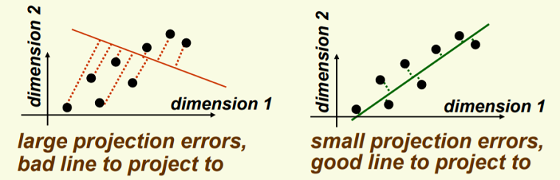
In the direction of largest variance the good line lies that is used for projection.
It is needed to modify the coordinate system so as to retrieve 1D representation for vector y after the data gets projected on the best line.
In the direction of the green line new data y and old data x have the same variance.
PCA maintains maximum variances in the data.
Doing PCA on n dimensions generates a new set of new n dimensions. Principal component takes care of the maximum variance in the underlying data 1 and the other principal component is orthogonal to it that is 2.

Slide 36
PCA VS FA
PCA components explain the maximum amount of variance while factor analysis explains the covariance in data.
PCA components are fully orthogonal to each other whereas factor analysis does not require factors to be orthogonal.
PCA component is a linear combination of the observed variable while in FA, the observed variables are linear combinations of the unobserved variable or factor.
PCA components are uninterpretable. In FA, underlying factors are labelable and interpretable.
PCA is a kind of dimensionality reduction method whereas factor analysis is the latent variable method.
PCA is a type of factor analysis. PCA is observational whereas FA is a modeling technique.

